Slide 1

Computer Vision (CV)
Lab4
Transfer Learning & Auto Encoder

Slide 2
Concatenate Layer
A concatenate layer in neural networks is used to combine multiple input tensors along a specified dimension.
concat = keras.layers.concatenate([ __ ,…, __ ],axis= 0 or 1 )

Slide 3
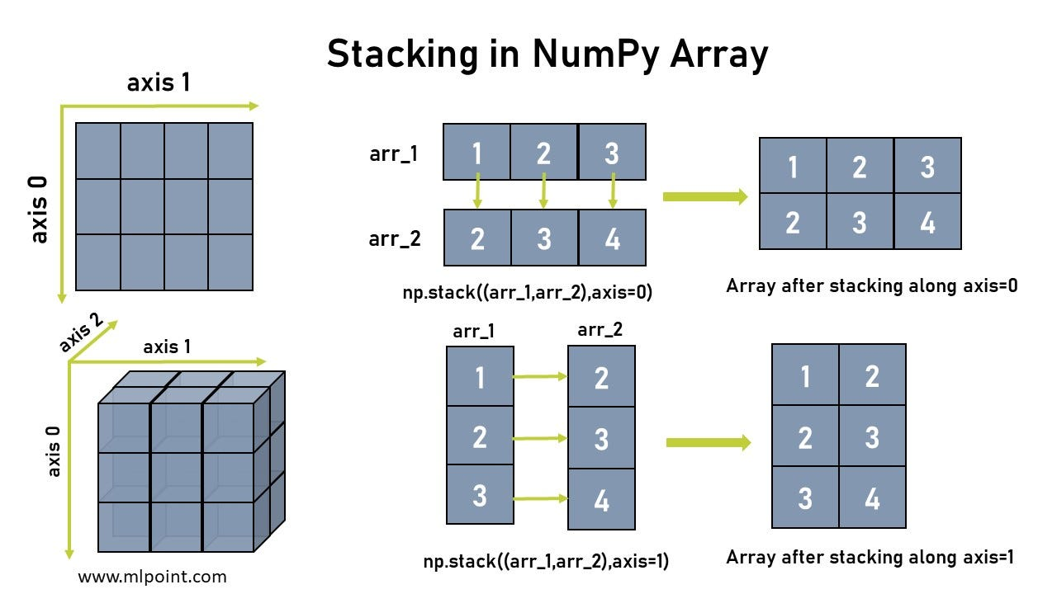
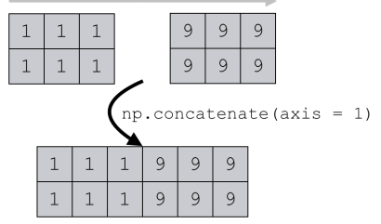
Concatenate Layer
concat = keras.layers.concatenate([input_A, input_B],axis=0)
concat = keras.layers.concatenate([input_A, hidden2],axis=1)

Slide 4
Concatenate Layer
input_A = keras.layers.Input(shape=[5], name="wide_input")
input_B = keras.layers.Input(shape=[6], name="deep_input")
hidden1 = keras.layers.Dense(30, activation="relu")(input_B)
hidden2 = keras.layers.Dense(30, activation="relu")(hidden1)
concat = keras.layers.concatenate([input_A, hidden2])
Aux_output = keras.layers.Dense(1, name="output")(hidden2 )
output = keras.layers.Dense(1, name="output")(concat)
model = keras.Model(inputs=[input_A, input_B], outputs=[output, Aux_output ])

Slide 5
Imagenet
ImageNet is an image database organized according to the WordNet hierarchy (currently only the nouns), in which each node of the hierarchy is depicted by hundreds and thousands of images. The project has been instrumental in advancing computer vision and deep learning research. The data is available for free to researchers for non-commercial use.
The most highly-used subset of ImageNet is the ImageNet Large Scale Visual Recognition Challenge (ILSVRC) 2012-2017 image classification and localization dataset. This dataset spans 1000 object classes and contains 1,281,167 training images, 50,000 validation images and 100,000 test images. This subset is available on Kaggle.
https://image-net.org/

Slide 6
What Is Transfer Learning? (TL)
• Transfer learning generally refers to a process where a model trained on one problem is used in some way on a second related problem.
• One or more layers from the trained model are then used in a new model trained on the problem of interest.
We can use a pre-trained model as
1- Feature Extraction Mechanism.
2- Use Architecture
3- Train Partially
Xception
VGG16
VGG19
ResNet50
InceptionV3
InceptionResNetV2
MobileNet
MobileNetV2
DenseNet
NASNet

Slide 7
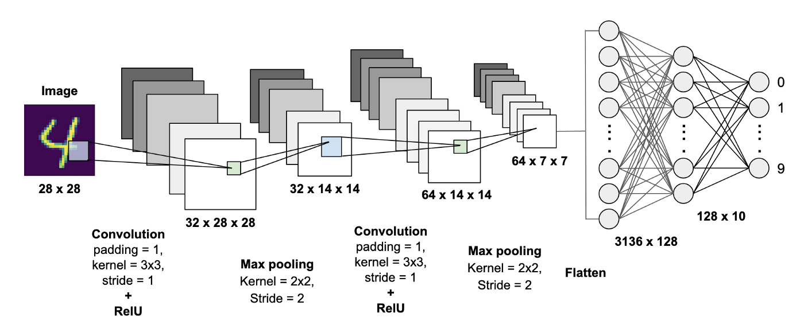
How Call Transfer Learning?
import tensorflow as tf
from tensorflow import keras
model = keras.applications.vgg16.VGG16(weights=' imagenet‘,
include_top=False,
input_shape=(224,224,3))
weights: one of None (random initialization) or 'imagenet' (pre-training on ImageNet).
include_top: whether to include the top layers of the network or not (False,True).

Slide 8
Feature Extraction Mechanism
import tensorflow as tf
from tensorflow import keras
model = keras.applications.vgg16.VGG16(weights='imagenet ' ,include_top=False ,input_shape=(224,224,3))
for layer in model.layers[:-1]:
layer.trainable = False

Slide 9
Use architecture
import tensorflow as tf
from tensorflow import keras
model = keras.applications.vgg16.VGG16(weights=None ,include_top=False ,input_shape=(224,224,3))
for layer in model.layers[:-1]:
layer.trainable = True

Slide 10
Train Partially
import tensorflow as tf
from tensorflow import keras
model = keras.applications.vgg16.VGG16(weights='imagenet ' ,include_top=False ,input_shape=(224,224,3))
for layer in model.layers[:5]:
layer.trainable = False

Slide 11
VGG19

Slide 12
ResNet50

Slide 13
InceptionV3

Slide 14
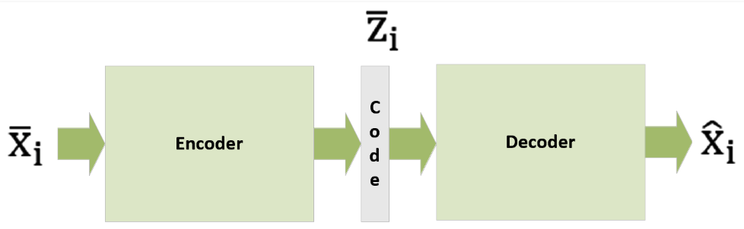
Autoencoder
Autoencoders are the models in a dataset that find low-dimensional representations by exploiting the extreme non-linearity of neural networks.
An autoencoder is made up of two parts:
Encoder : This transforms the input (high-dimensional into a code that is crisp and short).
Decoder :This transforms the short code into a high-dimensional input.

Slide 15
Autoencoder
Auto-encoders are used to capture structure in data, using unsupervised learning.
Data is providing as input, and the output of the network tries to reconstruct the input.
Learning is performed using backpropagation or related methods.
The network captures a reduced representation of inputs.
Useful for pre-training a network, improving learning and allowing greater depth.

Slide 16
Autoencoders Architecture
Autoencoders are multi-layer neural network with a specific topology.
The target output of the network is set to the input.
The aim of training is to minimize the error of reconstruction.
Often a reduced set of hidden units is used, creating an information bottleneck.

Slide 17
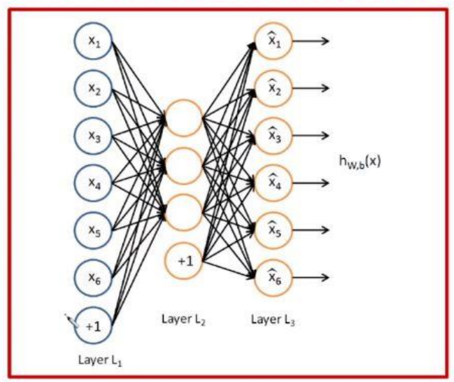
Auto encoders Architecture
Encoding the input data The Auto-encoder first tries to encode the data using the initialized weights and biases.
Decoding the input data The Auto-encoder tries to reconstruct the original input from the encoded data to test the reliability of the encoding.
Autoencoders -Machine Learning - GeeksforGeeks

Slide 18
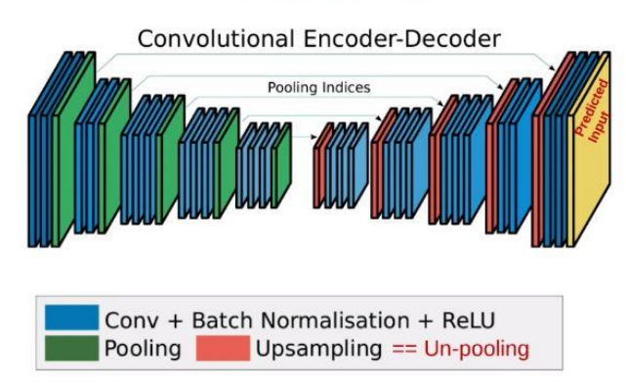
Convolutional Auto encoders Architecture
Convolutional Auto-encoder: Convolutional auto-encoders are a type of autoencoder that use convolutional neural networks (CNNs) as their building blocks. The encoder consists of multiple layers that take an image or a grid as input and pass it through different convolution layers thus forming a compressed representation of the input. The decoder is the mirror image of the encoder it deconvolves the compressed representation and tries to reconstruct the original image.

